Slide 1
Interventional Pulmonary Medicine
Assoc. Prof D-r Valev D. PhD

Slide 2
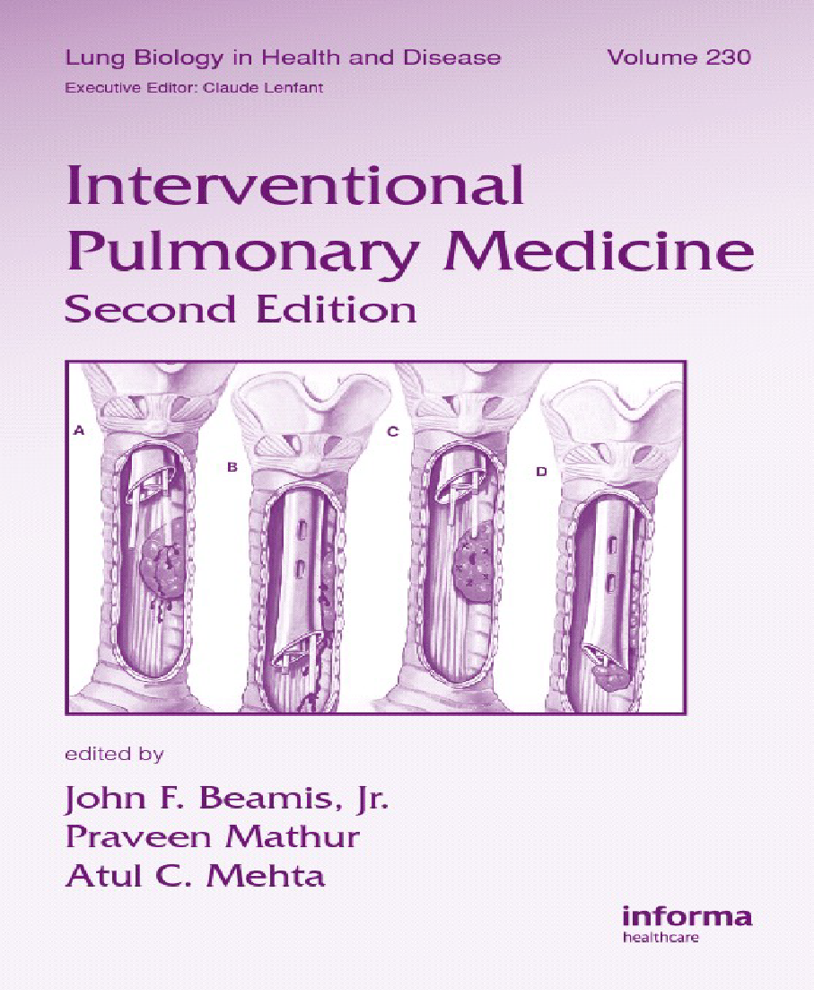
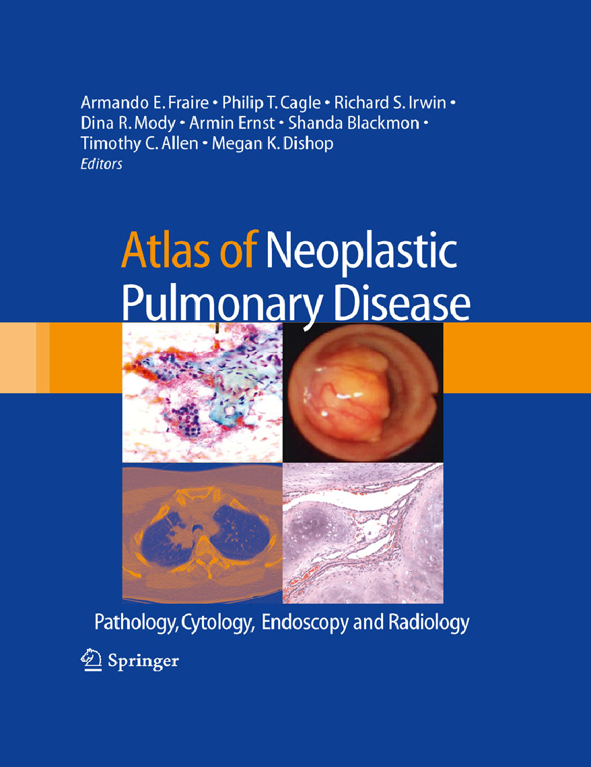
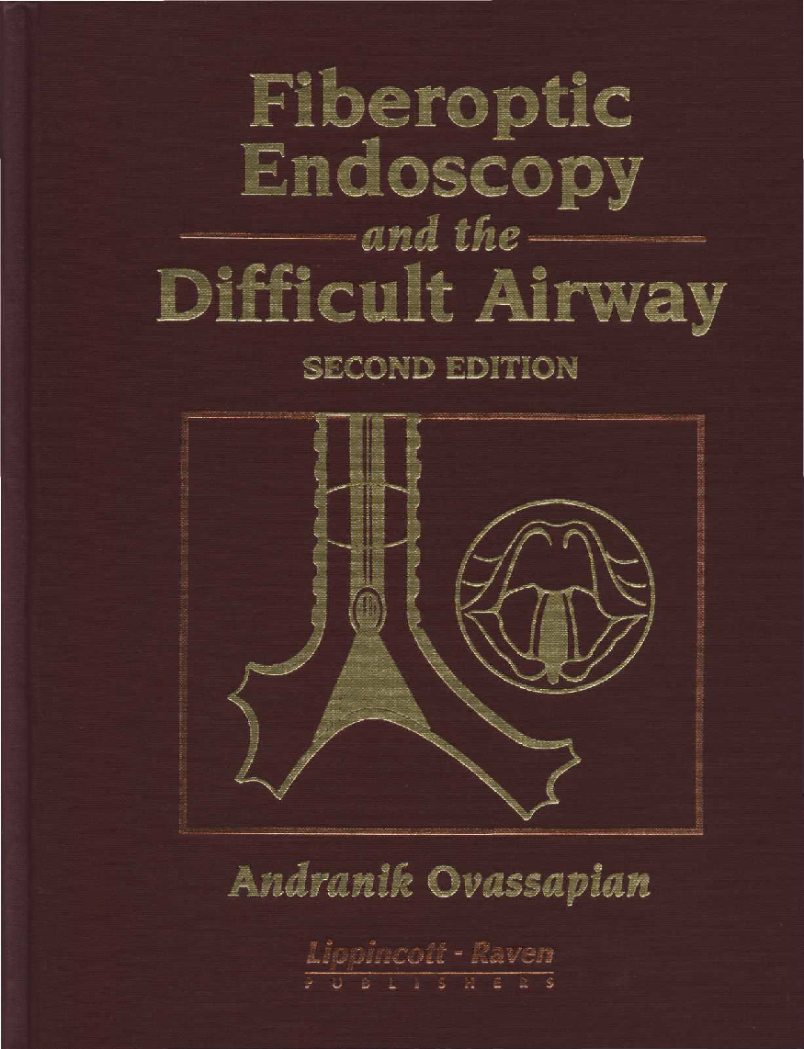
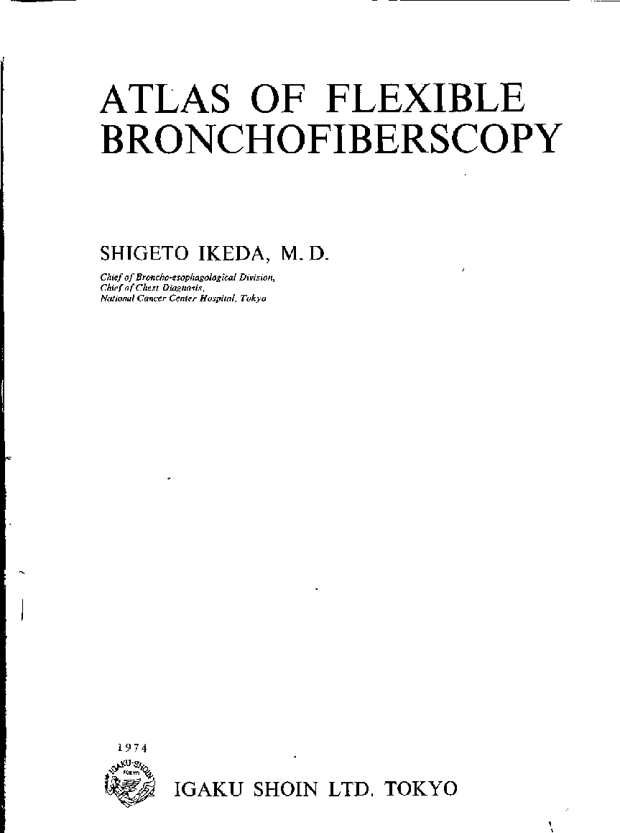
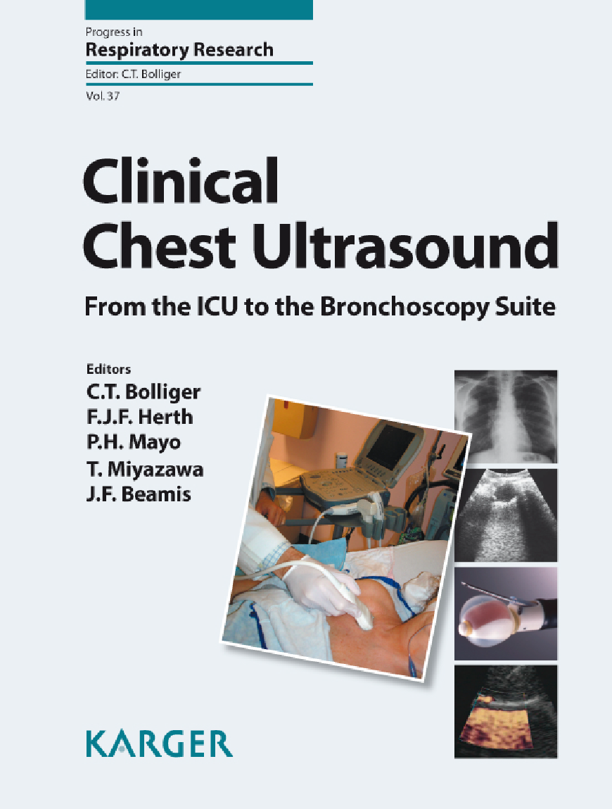
In the preparation of this presentation were used materials from:

Slide 3
A Short History of Bronchoscopy
Access to the airways in the living patient was tried already by Hippocrates (460–370 B.C.), who advised the introduction of a pipe into the larynx of a suffocating patient. Avicenna of Bukhara (about 1000 ad) used a silver pipe for the same purpose.
Desalt (1744–1795) advised nasotracheal intubation for treatment of suffocation and removal of foreign bodies. For ages, more than half of accidental inhalations of a foreign body caused the death or chronic illness of the patient because of purulent infection, abscess, fistulas, and malnutrition. Diverse instruments have been designed to remove those foreign bodies blindly from the airways via the larynx or a tracheotomy, called “bronchotomy”, which was also used for treatment of subglottic stenosis such as caused by diphtheria. Also, until late into the second half of the last century, a tracheotomy also had a high mortality of up to more than 50 percent; methods were developed for blind intubation.
When he presented his “Treatise on the Diseases of the Air Passages,” Horace Green in 1846, however, was blamed by the Commission of the New York Academy of Medical Sciences as presenting “. . . a monstrous assumption, ludicrously absurd, and physically impossible, . . . an anatomical impossibility and unwarrantable innovation in practical medicine” and was removed from the society, but Joseph O’Dwyer persisted and introduced the method for emergency intubation of diphtheric children.
Introduction to Bronchoscopy - Cambridge University Press

Slide 4
The First Endoscopes and Light Sources
In contrast to other fields of endoscopy, where daylight or candlelight could be introduced for inspection of the vagina, rectum, urethra, and so on, it was only after Philipp Bozzini, a general practitioner in Frankfurt, had developed his “illuminator” in 1805 that a suitable light source for the inspection of the trachea came within sight. The device consisted of a box containing a candle, the light of which was reflected by a hollow mirror into a “conductor,” a split metallic tube that could be spread by a simple mechanism.
The first suitable successor was in 1853: the instrument of Desormeaux, who also introduced the word “endoscope” for his instrument to inspect the body cavities (Figure 1.2). It was by Desormeaux’s endoscope that A. Kußmaul in 1867–1868 performed the first esophagoscopies.
Introduction to Bronchoscopy - Cambridge University Press

Slide 5
An illustration of the Desormeaux’s endoscope
Introduction to Bronchoscopy - Cambridge University Press

Slide 6
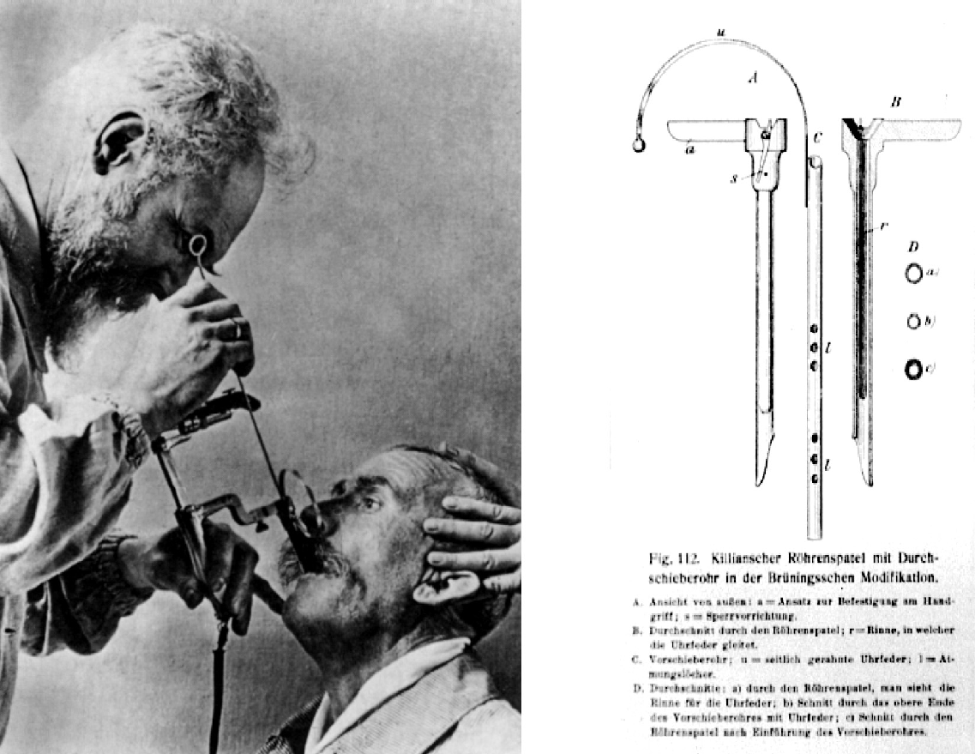
Development of bronchoscopy
Bronchoscopy was born in 1897, Gustav Killian dared to perform the first direct endoscopy via the larynx in a volunteer.
In the same year (1897), he removed the first foreign body via the trans laryngeal route on which his coworker Kollofrath reported in his paper.
He noticed the flexibility of the trachea and how easily he could adjust it to the angle of the main bronchi and introduce the endoscope down to the lobar level. “I think I have made an important discovery,” he noted afterwards.
Introduction to Bronchoscopy - Cambridge University Press

Slide 7
Rigid Bronchoscopy in the Twentieth Century
Because of enthusiastic activities of Killian and his assistants in teaching and spreading the new technique, hundreds of specialists all over the world learned bronchoscopy and many improvements were added to the instrument
In 1952 Riecker introduced relaxation by curare
In 1956 Maassen introduced bronchography via double-lumen catheter
Two companies, Storz and Wolf, became the most important instrument makers in Germany and introduced new technologies
E. Schiepatti of Buenos Aires introduced transtracheal puncture of the carinal lymph nodes, and Euler reported on pulmonary and aortic angiography by transbronchial puncture in 1948–1949 and later on the technique of rigid transbronchial needle aspiration (TBNA) for mediastinal masses in 1955, which was further perfected by Schießle in 1962.
On May 11, 1898, in the United States, A. Coolidge performed the first lower tracheobronchoscopy at Massachusetts General Hospital
Introduction to Bronchoscopy - Cambridge University Press

Slide 8
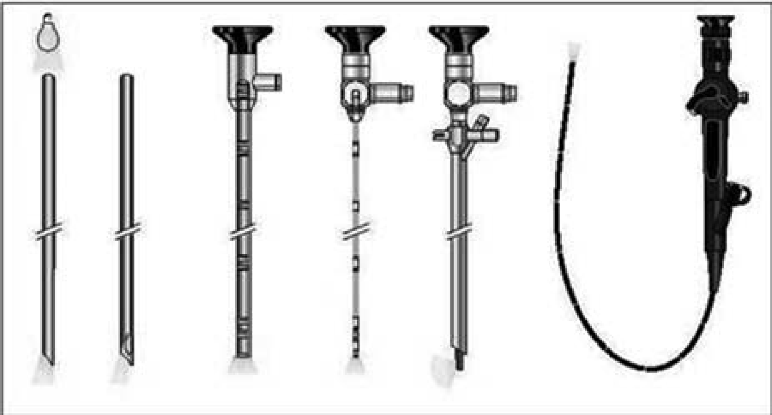
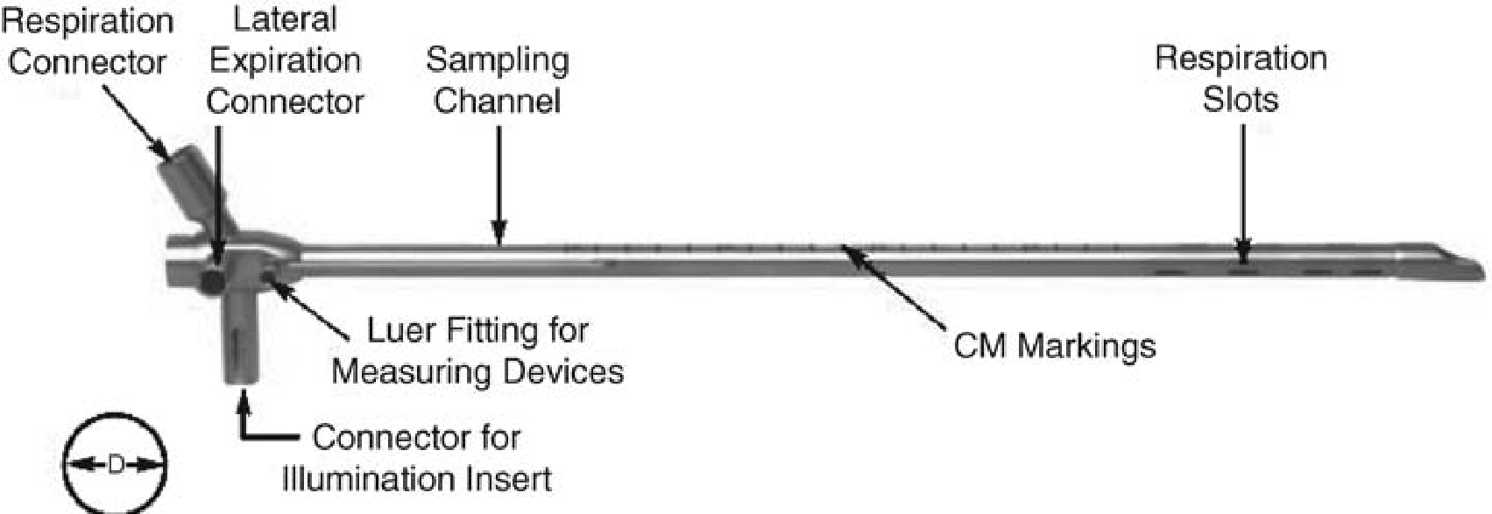
New Innovations in Rigid Bronchoscopy
The rigid bronchoscope is a stainless steel, hollow cylindrical tube with a lumen, which is equal along its length. The external diameter of the adult rigid bronchoscope ranges from 9 to 14 mm and is usually 40 cm long.
Rigid bronchoscopy is performed under general anesthesia
Jet ventilation is achieved through an open system where 100% oxygen is injected at 50 psi though one of the operator ports at the proximal end of the bronchoscope.
Introduction to Bronchoscopy - Cambridge University Press

Slide 9
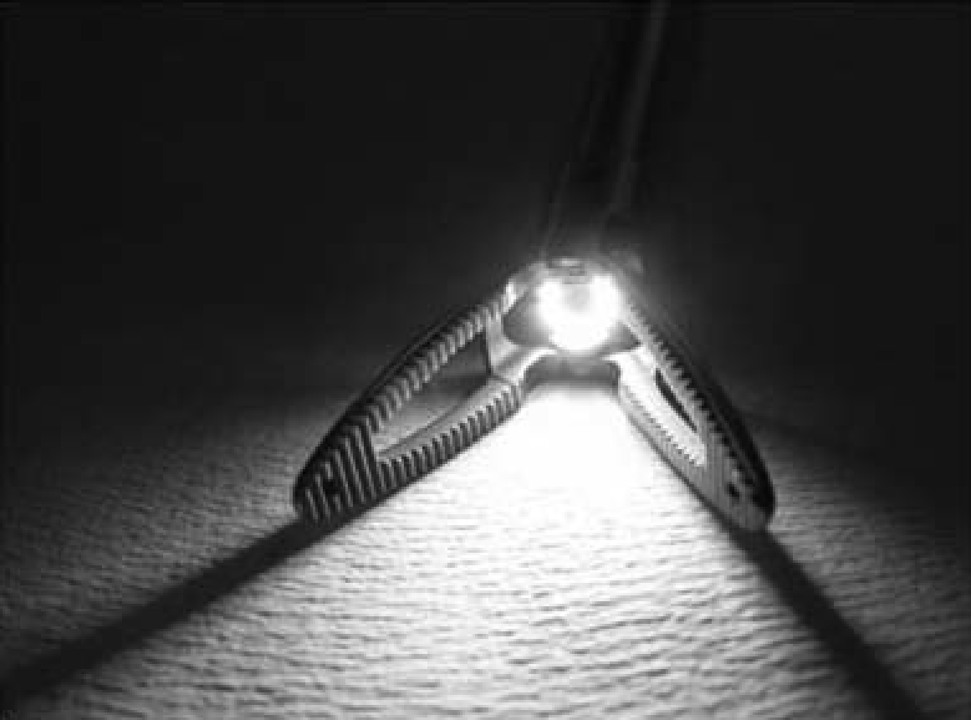
New Bronchoscopic Instrumentation
Optical Forceps are used for multiple modalities of bronchoscopic interventions :
Stent placement (repositioning, and removal)
Foreign body extraction and tumor excision
The first major new design in optical forceps is now being offered by Wolf. The new Optical Holding Forceps 3XL “Cyclops Forceps” has a centrally positioned 5.5-mm telescope that ensures optimum visualization in combination with mechanical stability
Rigid bronchoscopy has stood the test of time and remains the single most important instrument for the interventional pulmonologist for the diagnosis and treatment of airway pathology.

Slide 10
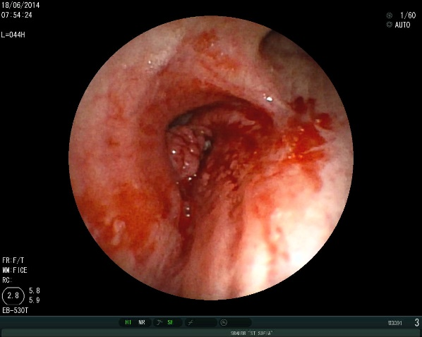
At the time of diagnosis, a good 80% of all lung cancers are inoperable and their treatment is mainly palliative. Obstruction of the major airways is one of the most serious complications of advanced stage tumors and can vary from asymptomatic airway narrowing to life-threatening dyspnea caused by airway occlusion
Significant central airway obstruction (CAO) with imminent suffocation requires immediate action to promptly regain airway passage (1,2). Airway obstruction is caused by intraluminal tumor growth, extraluminal tumor compression, or the combination of both (Fig. 1). Depending on staffing and equipment of the local health care facilities, patients with or without previous treatment are referred to the interventional pulmonologist
In these cases, rigid bronchoscopy is an indispensable technique

Slide 11
Flexible Bronchoscopy
In 1962 he approached Mr. Machida and asked for the development of a flexible broncho fiberscope with a diameter of less than 6 mm, containing approximately 15,000 glass fibers of less than 15 m. In 1964 he obtained the first prototype of this device and, after further improvement in the summer of 1966, he was able to present the first useful instrument at a meeting in Copenhagen.
In 1970 the first Olympus model was commercialized with better handling and imaging properties. In 1968 Ikeda demonstrated the new instrument at many international meetings.
In 1978 Ikeda organized the first World Congress for Bronchology (WCB) in Tokyo, and in 1979 he founded the World Association for Bronchology (WAB), of which he was elected the first chairman
Introduction to Bronchoscopy - Cambridge University Press

Slide 12
S. Ikeda demonstrating the first prototype of the flexible broncho fiberscope to the author
Introduction to Bronchoscopy - Cambridge University Press

Slide 13
Flexible bronchoscopy
Flexible bronchoscopy can be used to diagnose and treat lung disease
The most important part is the careful planning and discussion of the procedure with the anesthesiologist well ahead
Potential complications such as bleeding, hypoxia, barotrauma often depend on the nature of the lesion and/or the overall condition of the patient
Procedures exclusively performed with the flexible bronchoscope are usually done under local anesthesia, with or without transtracheal application of 2% lidocaine(2%-200mg)
Patients get additional intravenous conscious sedation with midazolam and/or propofol, If a patient is unable to maintain proper airway control, we use mostly a laryngeal mask or an ET tube, both with spontaneous ventilation
The procedure is remarkably safe with about 1–3% complication rate

Slide 14
Indications for diagnostic bronchoscopy
Malignancy
Diagnosis of bronchogenic carcinoma
Staging of bronchogenic carcinoma
Restaging after therapy and/or initial mediastinoscopy
Abnormal sputum cytology
Follow-up after treatment carcinoma
Evaluation of patients with head and neck malignancy
Evaluation of patients with esophageal malignancy
Metastatic carcinoma
Mediastinal mass
Infection
Recurrent or unresolved pneumonia
Infiltrate in an immunocompromised patient
Cavitary lesion
Unexplained lung collapse
Interstitial lung disease
Hemoptysis
Unexplained chronic cough
Localized wheezing
Stridor

Slide 15
Indications for diagnostic bronchoscopy
Foreign body aspiration
Chest trauma
Blunt or penetrating
Chemical
Thermal
Unexplained pleural effusion
Evaluation of the patient after lung transplantation
Endotracheal intubation
Confirm tube position
Evaluate for tube-related injury
Confirm position of transtracheal oxygen catheter
Tracheobronchial stricture and stenosis
Hoarseness or vocal cord paralysis
Superior vena cava syndrome
Fistula

Slide 16
Therapeutic bronchoscopy
Foreign body aspiration and removal - Aspiration of a foreign body served as the impetus for the first bronchoscopy. The bronchoscope continues to play a major role in this entity, avoiding the need for major surgical procedures.
Electrosurgery and argon plasma coagulation
Pulmonary toilet - most common therapeutic application of the bronchoscope. This is commonly required in patients who have an impaired cough mechanism from a variety of causes
Cryosurgery
Laser photo resection - Indications and contraindications for the appropriate use of endoscopic laser therapy are dependent upon the anatomic characteristics of the obstructing lesion and clinical condition
Photodynamic therapy
Brachytherapy
Drainage of lung abscesses
Bronchoalveolar lavage
Stents
Balloon dilation
Aspiration of cysts and other therapeutic procedures

Slide 17
Contraindications for bronchoscopy
Absolute contraindications
Inadequate oxygenation during the procedure
For rigid bronchoscopy:
Unstable neck
Severely ankylosed cervical spine
Restricted temporomandibular joint
Relative contradictions
Malignant arrhythmia
Unstable cardiac status
Refractory hypoxemia
Bleeding diathesis or severe thrombocytopenia (if biopsy is anticipated)
Factors associated with increased risk of complications
Uncooperative patient
Recent or unstable angina
Unstable asthma
Moderate to severe hypoxemia
Hypercarbia
Uremia

Slide 18
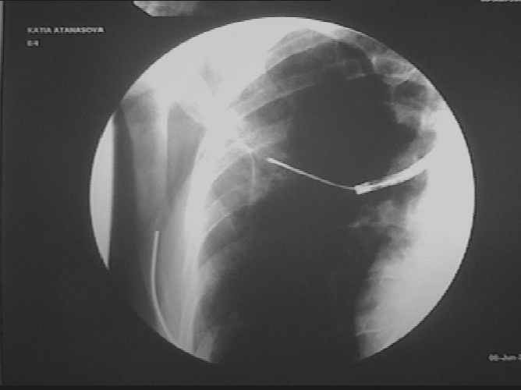
Bronchoscopic Lung Biopsy
Bronchoscopic lung biopsy (BLB) - also referred to as transbronchoscopic or transbronchial lung biopsy, is the technique by which biopsy of lung parenchyma can be obtained by using either the rigid or the flexible bronchoscope.
The photos show an X-ray-controlled lung biopsy

Slide 19
Pulmonary diseases in which bronchoscopic lung biopsy provides a higher diagnostic yield
Pulmonary Langerhan’s cell histiocytosis (histiocytosis X)
Lymphangitic carcinomatosis
Pulmonary alveolar proteinosis
Diffuse lung infections caused by mycobacterium and mycoses
Diffuse pulmonary lymphoma
Diffuse alveolar cell carcinoma
Lymphagioleiomyomatosis
Silicosis

Slide 20
Absolute contraindications to BLB
Absolute contraindications
Unstable cardiovascular status
Status asthmaticus
Severe hypoxemia during bronchoscopy
An inadequately trained bronchoscopist or bronchoscopy team
Inadequate instruments to perform the procedure properly

Slide 21
Relative contraindications to BLB
Uncontrollable cough during the procedure
Untreated hemorrhagic diatheses
Advanced renal failure
Significant hypoxemia in a patient with a single lung
Extensive bullous changes in areas to be biopsied
Suggestion of vascular malformations adjacent to areas to be biopsied.

Slide 22
Bronchoalveolar Lavage
Technique
After the bronchoscope is wedged, sterile saline is infused with a syringe into the suction port of the bronchoscope. Mixed data are found regarding the use of warmed saline.
Prewarming the lavage fluid to 37°C may help preventcoughing and bronchospasm, especially in patients with hyper-responsive airways, and may increase fluid recovery and cellular yield in comparison to instillations of fluid at room temperature
Most institutions use aliquots of 20 to 60 mL. There are no significant data to support a specific aliquot size.
The volume of fluid infused is an important variable between institutions. Larger amounts of lavage fluid (up to 240 to 300 mL) have been used, particularly if a larger number of inflammatory cells are required; but it is generally agreed that increased patient morbidity may result, particularly local atelectasis and transient fevers

Slide 23
Sample processing
Recovered fluid should be collected into traps made of material to which the cells are poorly adherent, such as polyethylene or polycarbonate; unsiliconized glass materials should not be used [5,7]. Macrophages, in particular, have shown to be adherent to glass. Specimens should be transported to a laboratory for evaluation within 1 hour
Cellular analysis—normal values
BAL in healthy non-smokers produces 100,000 to 150,000 cells per mL of lavage fluid obtained [15]. BAL in a normal non-smoking adult will yield 80 to 95% macrophages, 5 to 15% lymphocytes, CD4/CD8 ratio of 1.5 to 1.8, less than 3% neutrophils, and less than 1% eosinophils, basophils, and mast cells
Clinical utility
In most situations, BAL, by itself, does not provide information to make specific diagnoses with absolute certainty. However, BAL has important diagnostic value when considered in conjunction with other information. If patients cannot safely undergo open lung biopsy, BAL can provide supportive evidence for a diagnosis, and if a patient has respiratory symptoms but near normal pulmonary functions and a normal chest X ray, an abnormal BAL result facilitates the decision to proceed with open lung biopsy

Slide 24
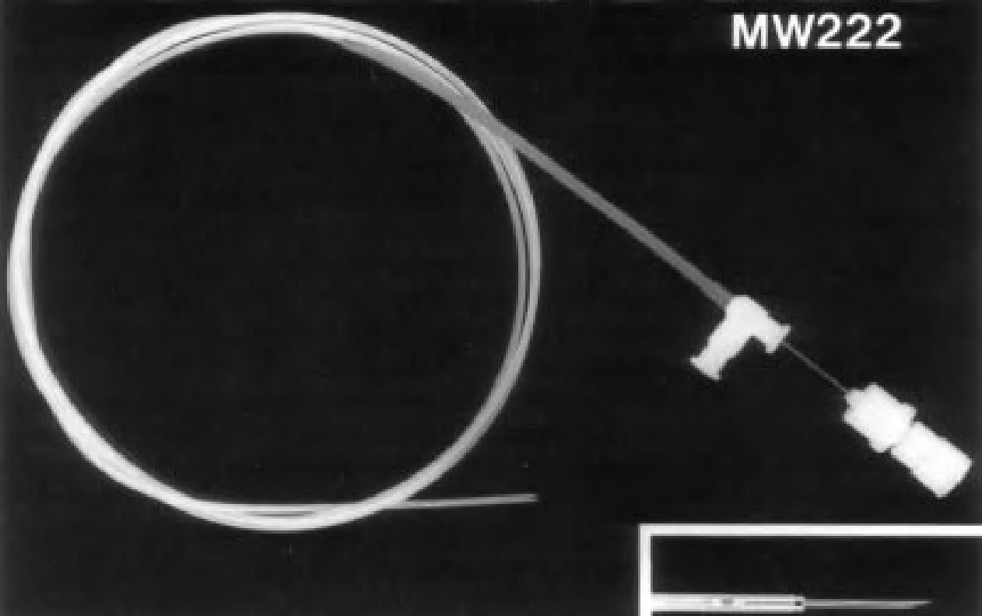
Transbronchial Needle Aspiration for Cytology and Histology Specimens
History of transbronchial needle aspiration was presented by Dr Eduardo Schieppati in 1949 at the Argentine Congress of Bronchoesophagology.
With the availability of the flexible bronchoscope, Dr Ko-Pen Wang of Johns Hopkins Hospital in Baltimore designed and utilized an innovative needle construction to perform transbronchial needle aspiration through this new flexible instrument
The original Wang TBNA needles for use in the diagnosis of central and peripheral lesions were designated as three types: IA, IIA, IIIA. These incorporated a basic design of a 120-cm long semitranslucent catheter with an inner steel stylet ending in a 1.3-cm beveled or flattipped 22-gauge needle.

Slide 25
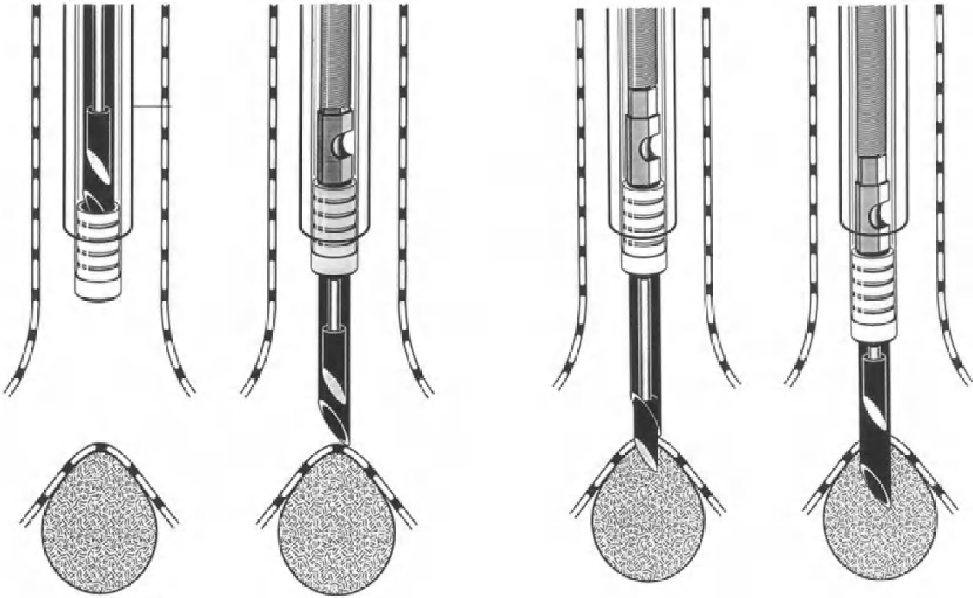
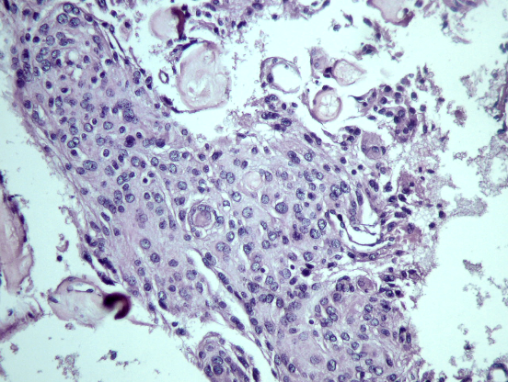
Biopsy technique
The TBNA technique for histology specimens: (step 1) hub is visible; (step 2) advance and lock the needle, both 21 and 19 gauge needles are advanced; (step 3) lodge needle tip into mucosa; (step 4) use pushing technique to penetrate bronchial wall. From: Dasgupta A, Mehta AC.
Transbronchial needle aspiration: an underused diagnostic technique.
Clin Chest Med 1999; 20: 43.

Slide 26
The Utilization of Autofluorescence in Flexible Bronchoscopy
Lung cancer is the most common cause of cancer deaths worldwide
Less than 16% of lung cancer patients survive 5 years or more, owing to late diagnosis and a paucity of effective therapies
In contrast to the poor survival of patients with advanced disease, the survival of those with carcinoma in situ (Stage 0) or microinvasive disease is up to 90%
Principles of photonic imaging
When the bronchial surface is illuminated by light, the light can be reflected from the surface (specular reflection), absorbed, induce autofluorescence, travel in the bronchial tissue and back-scattered at the same wavelength as the incident light (elastic scattering), or scatter at a different wavelength (inelastic or Raman scattering) due to light energy modification by the vibrational state of molecules

Slide 27
Principles of photonic imaging
White-light bronchoscopy (WLB) makes use of the specular reflection, back scattering, and absorption properties of broadband visible light from approximately 400 to 700 nm to define the structural features of the bronchial surface and discriminate between normal and abnormal tissues
To highlight the vasculature, narrow-band blue light, centered at 415 nm, and green light, centered at 540 nm, corresponding to the maximal hemoglobin absorption peaks, are used instead. The blue light highlights the superficial capillaries while the green light can penetrate deeper to highlight the larger blood vessels in the submucosa. This is called narrow-band imaging (NBI) and is often used in conjunction with high magnification video bronchoscopy. NBI provides more detailed images of the microvasculature in preneoplastic and neoplastic lesions, reflective of the altered angiogenesis process
Upon illumination by violet or blue light (380 to 460 nm), normal bronchial tissues fluoresce strongly in the green (480 to 520 nm). As the bronchial epithelium changes from normal to dysplasia, and then to carcinoma in situ and invasive cancer, there is a progressive decrease in green autofluorescence but proportionately less decrease in the red fluorescence intensity

Slide 28
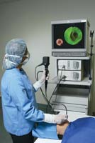
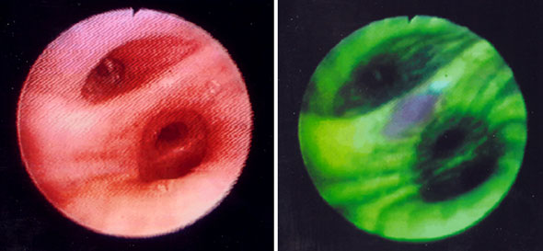
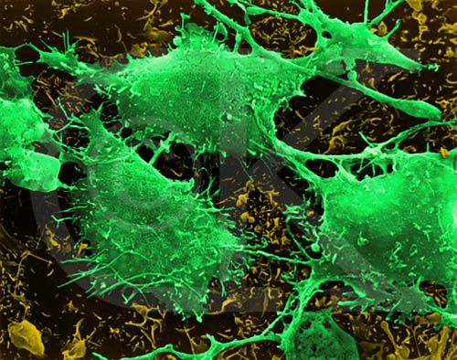
AUTOFLUORESCENT BRONCHOSCOPY

Slide 29
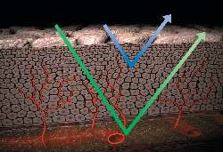
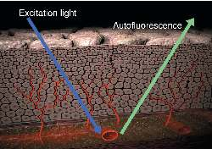
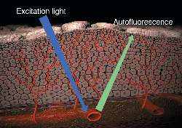
normal mucosa
hyperplastic mucosa

Slide 30
AUTOFLUORESCENT BRONCHOSCOPY
Autofluorescence bronchoscopy plays an important role in the localization of preinvasive and early invasive bronchial lesions, delineation of the extent of tumor spread, and for guiding bronchoscopic biopsy.
Localization of early central lesions enables minimally invasive endobronchial treatment without removing adjacent normal lung tissue. False positive fluorescence can occur in areas with inflammation or severe mucus gland hyperplasia. Quantifying the red to green fluorescence ratio of target sites can improve the specificity.
The role of autofluorescence bronchoscopy as part of a multimodal early lung cancer detection program needs to be investigated further.

Slide 31
Endobronchial Ultrasound
Within the central airways, the endoscopist’s view is restricted to the lumen and to the internal surface. Intramural processes and those adjacent to the airways, as well as mediastinal structures, can only be assessed from indirect signs, including discoloration, displacement, and destruction of anatomical structures.
As external mediastinal ultrasound and transesophageal endosonography proved insufficient for exploration of the mediastinal structures, in 1989 we approached the Olympus Co. for the development of endobronchial ultrasound (EBUS), first using miniaturized radial scanning probes which were applied in the gastrointestinal tract (EUS) and cardiovascular endosonography, preliminary experience of which had been reported in endovascular sonography of the pulmonary artery to exclude tumor invasion
After extensive experience with dedicated radial ultrasound probes, in addition bronchoscopes with integrated linear electronic transducers were developed with Doppler function for visualization of vessels and real-time observation of transbronchial needle aspiration

Slide 32
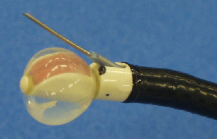
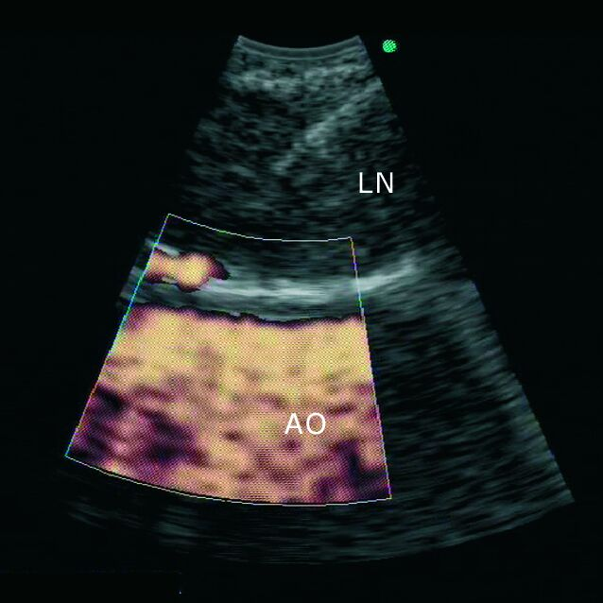
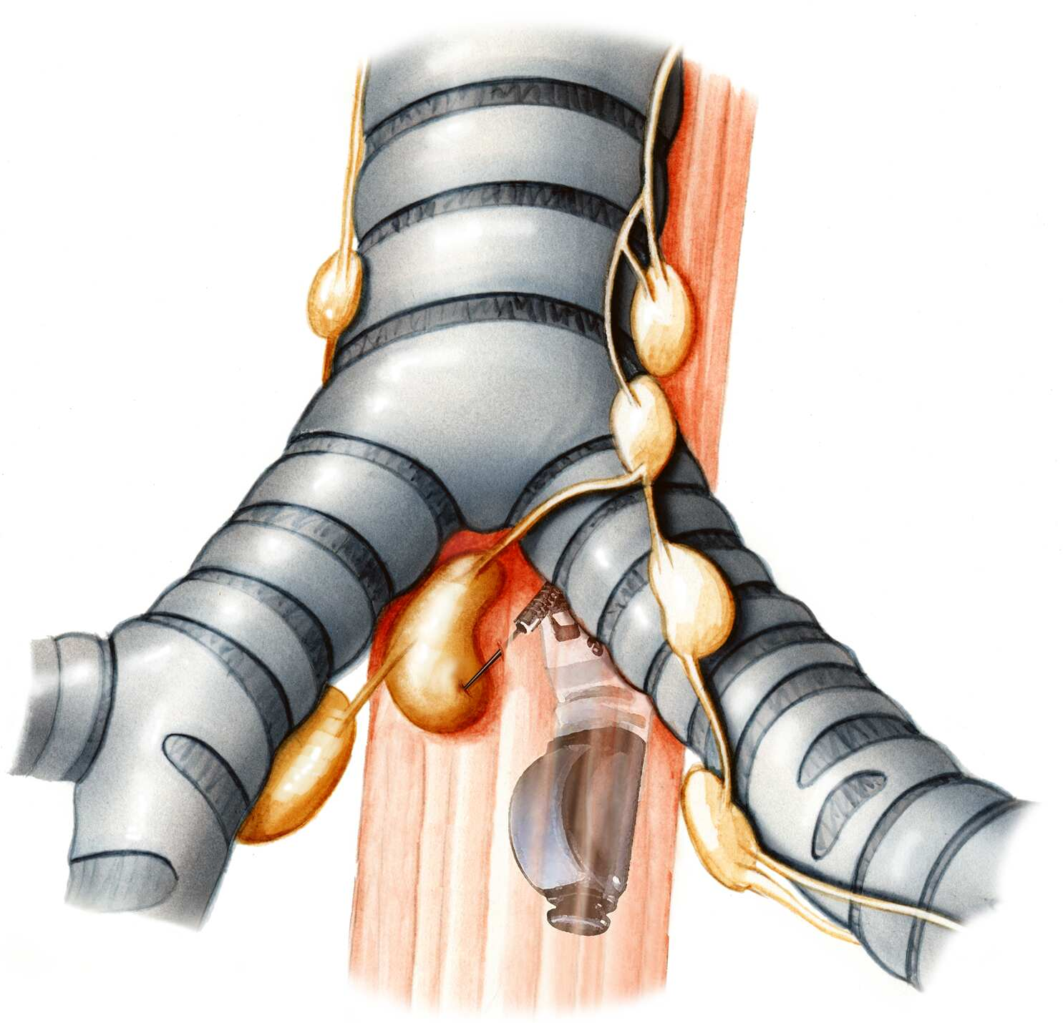
There are two basic devices of EBUS systems: miniaturized probes with radial mechanical transducers and linear electronic transducers, which are integrated into the tip of bronchoscopes. In the radial probes the transducer is attached to
a wire that is rotated by a motor to send out waves perpendicular to the axis of the bronchi and provides a 360° surround view of the airways and adjacent mediastinal structures. The linear electronic transducers provide a sectorial
view along the axis of the bronchi and by Doppler function can give information on intravascular blood flow. Currently, mechanical transducers have higher frequencies of 20 and 30 MHz, which give higher resolution of structures,
but less penetration into distant structures. Electronic transducers have frequencies of 5–10 MHz, with less resolution but higher penetration

Slide 33
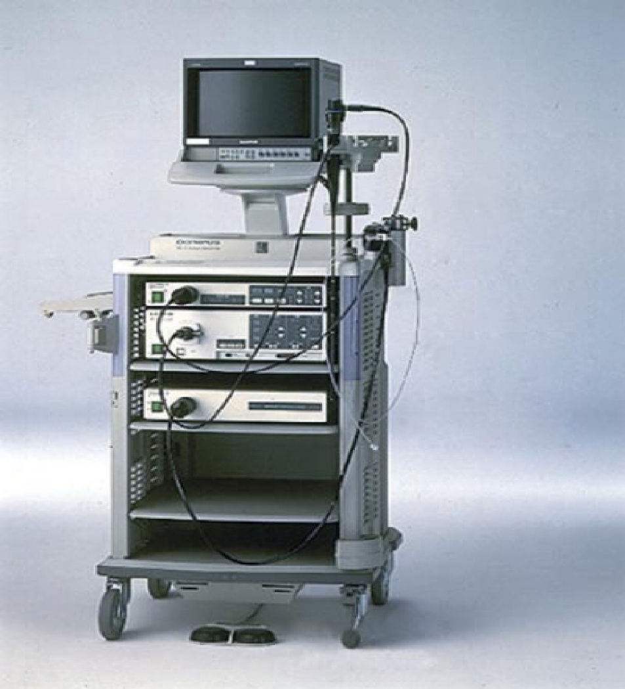
By the application of EBUS, diagnostic and therapeutic decisions can be made immediately during bronchoscopy without the need for further time-consuming and costly procedures. As has been shown by the introduction of the ultrasonic bronchoscope, interest in this new technique has increased significantly, and we are currently observing the beginning rather than the end of a development that will provide an
ever-increasing range of instruments and applications.

Slide 34
Application of Laser, Electrocautery, Argon, Plasma Coagulation, and Cryotherapy in Flexible Bronchoscopy
Benign or malignant tracheobronchial obstruction can lead to acute respiratory distress or even asphyxia and death. Endobronchial obstruction may present as an endobronchial lesion, or an extraluminal obstruction, or sometimes a combined endobronchial and extraluminal form
If curative resection is not possible, various endoscopic methods for palliation are available, such as Nd : YAG laser therapy, cryotherapy, electrocautery, and argon plasma coagulation. In cases of extraluminal lesions, palliation is performed by balloon dilatation, stent placement, and/or external beam radiation, which are discussed in other chapters
These lesions may be detected on chest radiography or CT scan, but direct airway visualization with bronchoscopy is often needed to define the lesion. Bronchoscopy will determine the appropriateness of treatment, for example by removing a foreign body or using a laser to debulk a tracheal tumor. When treatment is not emergent, therapy may be determined by the histology of an obstructing lesion, potential curative therapy, properties of the lesion such as location, endobronchial mass with complete or partial obstruction, extrinsic compression, malacia, etc., and patient tolerance and acceptance.

Slide 35
Application of Laser in Flexible Bronchoscopy
The two most commonly used media in interventional bronchology are the carbon dioxide (CO2) and neodymium : yttrium–aluminum–garnet (Nd : YAG) Lasers
In the CO2, laser light is produced in the infrared spectrum at a wavelength of 10,600 nm. The CO2 laser has an exact interaction with soft tissue, owing to its almost complete absorption by most tissues. When the CO2 laser contacts tissue, the water content of the tissue is raised to temperatures of 100°C with subsequent vaporization. The CO2 laser can be used as a precise cutting tool, with only minimal blood loss, owing to a relatively shallow depth of penetration.
The most widely used laser light for tracheobronchial lesions is the Nd : YAG laser, which is produced by the stimulation of an yttrium–aluminum–garnet glass, coated with neodymium. The Nd : YAG laser has a wavelength of 1064 nm and is easily transmitted through pale tissues, with sizeable scatter and a potential penetration of up to 5 to 10 mm from the focal point

Slide 36
Application of Electrocautery in Flexible Bronchoscopy
Electrocautery uses an electric current to produce heat and to destroy tissue. Strauss and colleagues used electrocautery for treating gastrointestinal tumors in 1913, and in 1935 reported their experience on over 40 cases. Electrocautery uses alternating current at a high frequency (105 to 107 Hz) to generate heat that coagulates, vaporizes, or cuts tissue depending on the power
Coagulation involves high amperage and low voltage, whereas vaporization uses high voltage and low amperage. Cutting tissue with the ability to coagulate blends these two settings. At a temperature of approximately 70°C tissue coagulates and over 200°C tissue carbonizes. The degree of destruction depends on the applied power, the electrical properties of the tissue, the device–tissue contact time, and the device–tissue contact surface area
When a tissue is heated sufficiently, cellular water evaporates, thereby destroying the cell and then the tissue. Heating to higher temperatures leads to chemical breakdown of the cell and tissue constituents and eventual vaporization/ carbonization. Electrocautery devices are monopolar; that is, they require the bronchoscope, the generator, and thepatient to be grounded to complete the circuit, or otherwise shocks and burns may occur. The bronchoscope should be insulated.

Slide 37
Application of Argon Plasma Coagulation in Flexible Bronchoscopy
Argon plasma coagulation (APC) is an electrosurgical technique similar to laser or electrocautery, used to remove an obstructing lesion and/or to achieve homeostasis. APC was developed more than 20 years ago to improve surgical hemostasis. In the early 1990s, a flexible probe was introduced that facilitated its use during endoscopic procedures. APC has been used during bronchoscopic procedures to debulk malignant airway tumors, control hemoptysis, remove granulation tissue from stents or anastomoses, and treat a variety of other benign disorders
Similar to electrocautery, a grounding pad should be placed on the patient back. The settings should be power of 30 watts and an argon flow rate of 0.8 to 1 L/min. The argon flow rate will determine the length of the flame. As the argon will seek biological tissue or any combustible object, the flame length is important in its airway application. This ensures that the bronchoscope will not be burned. The probe tip should be within 1 cm of the target lesion. The electric current will not be conducted if the probe is further from the target lesion

Slide 38
Application of Cryotherapy in Flexible Bronchoscopy
Documents from 3500 BC described the use of cold as treatment for swelling and war wounds [43]. Hippocrates described the use of cold to treat orthopedic injuries. Arnott described the use of salt solutions containing crushed ice at a temperature of about −8 to −12°C to freeze advanced cancers in accessible sites, producing a reduction in tumor size and improvement of pain
Cryotherapy deals with the destruction of biological materials through the cytotoxic effects of freezing. The damage induced by freezing occurs at several levels, including the molecular, cellular, and structural levels and the whole tissue. The effect of freeze injury is influenced by many factors and the survival of cells is dependent on the cooling rate, the thawing rate, the lowest temperature achieved, and repeated freezing thawing cycles
There are three parts to the cryomachine: the console, the cryoprobe, and the transfer line that connect the console and gas cylinder to the probe. Cryoprobes are flexible can be used through the channel of the fiberoptic bronchoscope. The efficacy of a cryoprobe depends in part on its diameter, thus if a fiberoptic bronchoscope is used, the operative lumen must be as large as possible (2.6 to 3.2 mm)

Slide 39
Foreign Body Aspiration and Flexible Bronchoscopy
The flexible bronchoscopy is the “gold standard” for the diagnosis of an airway foreign body and is the preferred instrument for its removal in adults. Aspiration of foreign bodies occurs most commonly at the extremes of age—the young and the elderly. Although the symptoms are non-specific, a detailed history and physical exam, as well as chest X rays, are invaluable. Most often, the diagnosis can only be made through direct visualization with the flexible bronchoscope. In most cases in adults, the removal can be accomplished during the initial bronchoscopic procedure
In children, the most common procedure performed for removal of foreign bodies is by the rigid bronchoscopy, with or without the use of adjuvant flexible bronchoscopy. However, in recent years data have emerged that support use of the flexible bronchoscope among pediatric patients as well.
Foreign body aspiration (FBA) is most common in early childhood (<5 years old) and amongst the elderly.
Unfortunately, death from asphyxiation still occurs, and usually occurs at home (41%), restaurants (29%), or in nursing homes or mental institutions (14%). Approximately 3700 (1.2 per 100,000 population) cases of death due to choking were reported in 2007 in the United States.

Slide 40
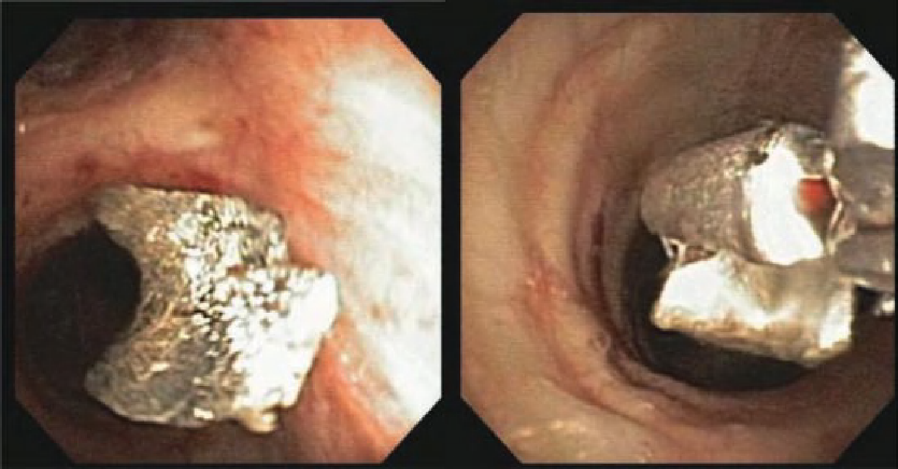
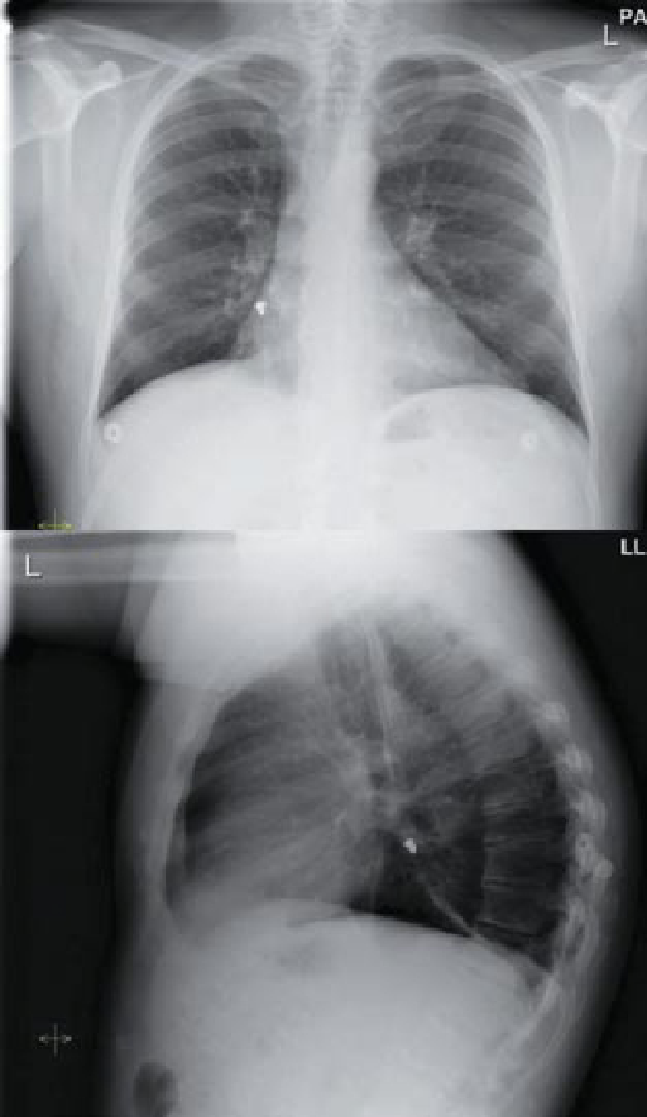
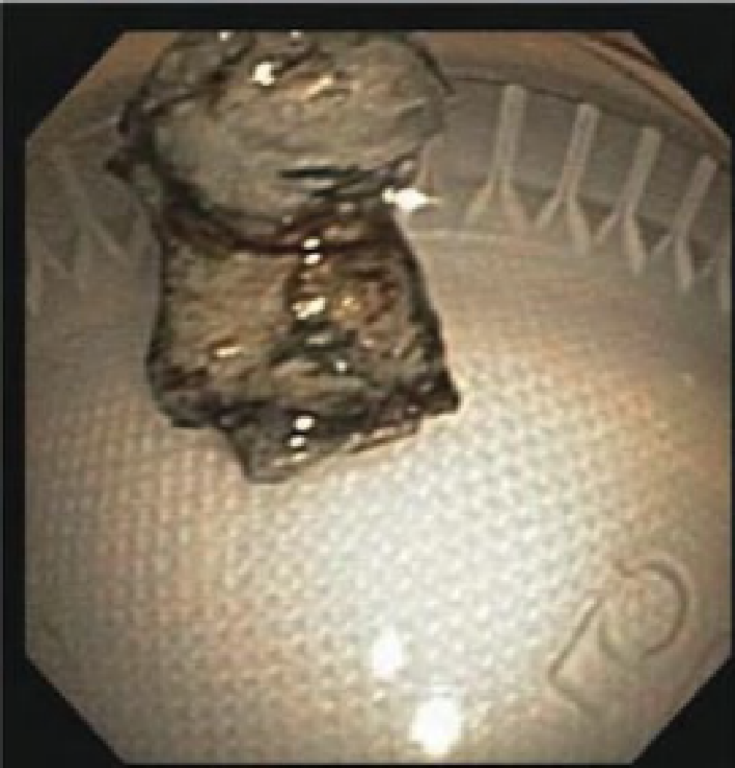
Foreign Body Aspiration and Flexible Bronchoscopy

Slide 41
THANK YOU FOR YOUR ATTENTION

