Slide 1

INTERNATIONAL PARTNERSHIPS FORUM

Slide 2

The international forum demonstrates internationalization in action, giving the opportunity to hear the voice of partners, to share ideas for new projects, presents examples of sustainability of collaborations in the key activities of our educational institution and contributed to raising the international prestige and visibility of MU - Varna.

Slide 3

Eighth International Partnerships Forum
Developing competences and skills through internationalization
19 October 2023

Slide 4
Main acent: The role of international partnerships in the development and implementation of projects in the fields of education and research.
Purpose: Celebrating four anniversaries through the perspective of internationalization and strategic partnerships of Medical University – Varna:
60th anniversary of the establishment of the Department of Social Medicine and Health Care Organization
60th anniversary of the establishment of the Department of Pediatrics
The 30th anniversary of the successful development of the specialty "Health Management"
15th anniversary of the establishment of the Faculty of Pharmacy

Slide 5
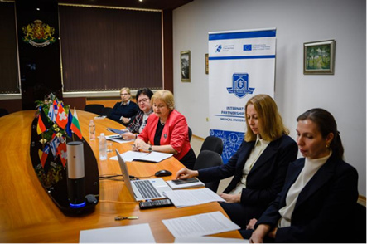
Programme:
Strategic partnerships and projects in the field of public health
Caring for our children in cooperation with our international partners
Preparing the future leaders in health care together with international partners. 30 years of successful development and partnerships in the field of health management
Partnerships between academia and business in the field of pharmacy

Slide 6
Seventh International Partnerships Forum
Partnerships for education and research through international projects
18 November 2022

Slide 7
Main focus:
The role of international partnerships in the development and implementation of MU - Varna projects in the field of education and research
Purpose and Scope:
Portfolio of project activities of MU-Varna;
Overview of operational programs, completed and ongoing projects in the period 2012-2022.

Slide 8
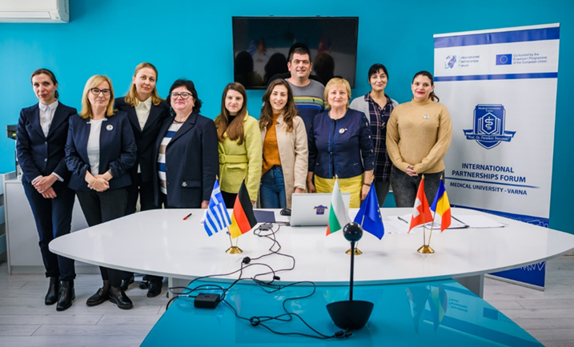
Programme:
Session 1: Partnerships in education. Sharing experience with Bulgarian and foreign MU-Varna partners
Session 2: Partnerships in research through EC programmes. Sharing experience with Bulgarian and foreign MU-Varna partners

Slide 9
Sixth International Partnerships Forum
60 Years of Building Synergies:
Education, Innovation and Partnerships
8 October 2021

Slide 10
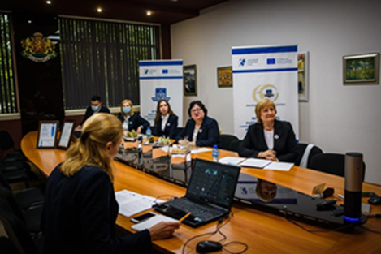

Inspired and dedicated to the 60th anniversary of the establishment of the Medical University - Varna.
A 60-year history of creation, creativity and professionalism.

Slide 11
Objectives:
To prove that this event has turned into an innovation gathering all partners together by creating networks, new partnerships and projects among them;
To demonstrate that the Forum presents internationalisation in action by giving voice to partners to share experience and ideas;
To exemplify the synergy of participants of various profiles, in which the added value exceeds the immediate outcomes;
To demonstrate systematic sustainability of the partnerships in the core fields of university activities – education, research and innovation.

Slide 12

Digitalisation in Education and Health
Fifth International Partnerships Forum
8 October 2020

Slide 13
Scope and Purpose
Digitalization during times of pandemics has proved to be crucial for the modernization in all fields of public and social life.
The purpose is to share our experience and ideas for meeting the new challenges of sustaining partnerships and achieving a better quality of education, treatment and science
Along with digitalization, we will also discuss the human resources development. We will dedicate special topics to the international year of nursing and midwifery, for which 2020 is proclaimed by the World Health Organization.

Slide 14
Programme
Session 1: Digitalisation in human resources
Session 2: Partnerships in digitalisation – sharing experience with Bulgarian and foreign MU-Varna partners
Session 3: Directions and forms of partnerships development to achieve better quality of training, treatment and research

Slide 15

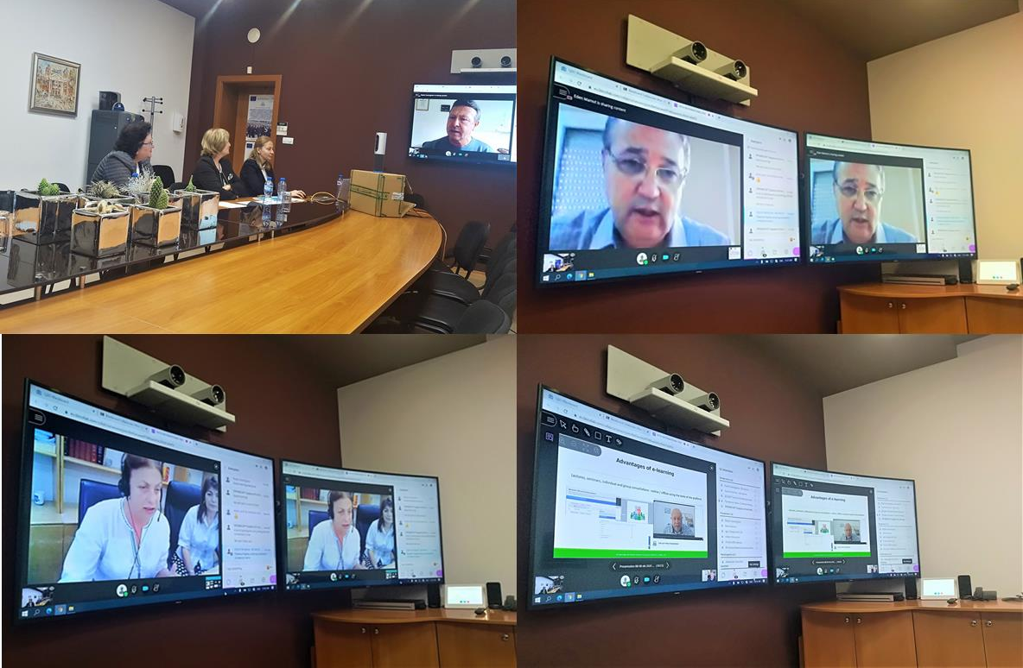
Among the international participants were representatives from the Black Sea University Network (BSUN), European Health Management Association (EHMA), Switzerland, USA, Portugal, Estonia, etc.

Slide 16
Partnerships for Business, Innovation and Science
Fourth International Partnerships Forum
26 - 27 September 2019

Slide 17
Purpose - development of regional innovation ecosystems through:
improving regional innovation performance;
enhancing universities’ research activities;
playing a crucial role in developing, attracting and retaining human capital;
promoting business models in education and practice;
improving social equity.

Slide 18
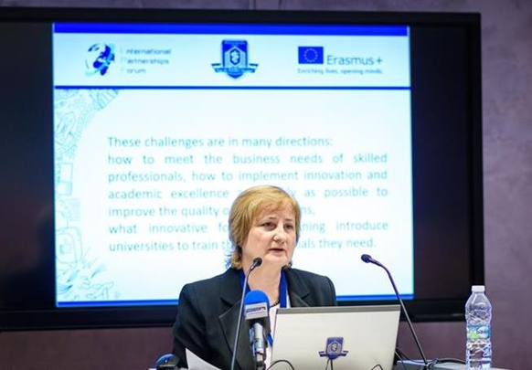
The programme
Session 1 : Policies and Programmes for Developing Innovation Potential
Session 2 : University Research and Innovation Implementation
Session 3 : University – Business Collaboration

Slide 19
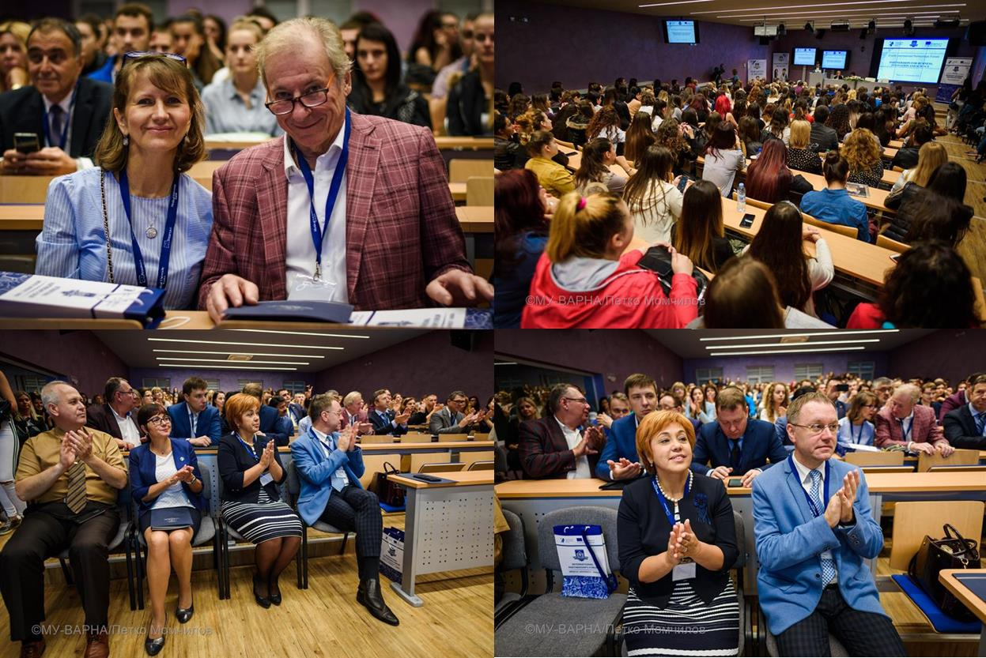
The event brought together old friends and created new collaborations. Among the guests were a 16-member delegation from the Tver State Medical University in Russia, representatives of the Medical Institute of Continuing Education in Moscow, the AO Foundation research institute in Davos, the Federal Cardiovascular Center in Penza, and others.

Slide 20
International Partnerships Contribution to Universities Internationalisation
Third International Partnerships Forum
25 - 26 October 2018

Slide 21
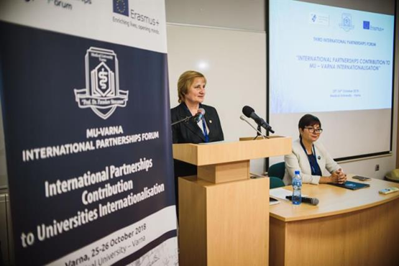
Main topic - “International Partnerships Contribution to Universities Internationalisation”, dedicated to 25th anniversary of the specialty оf healthcare management and 10th anniversary of the Faculty of Pharmacy.

Slide 22
Main accent
Universities internationalisation as a powerful tool for the development of higher education worldwide.
Medical University of Varna integrates the global perspectives and the intercultural dimension in the teaching-learning process and research.

Slide 23
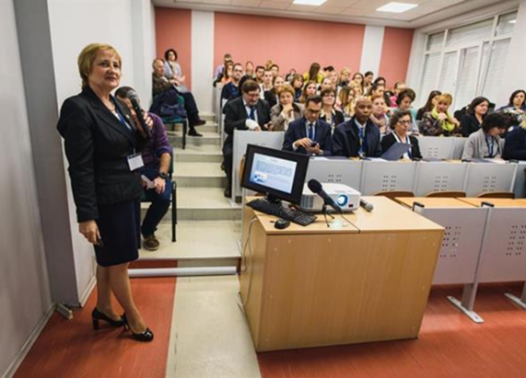
The presentations and discussions focused on different models of internationalization working for the different partnerships of the MU-Varna.
In accordance to the new requirements of the national and international accreditation systems.

Slide 24

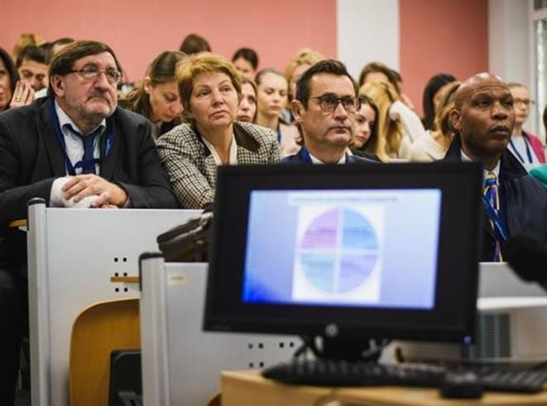
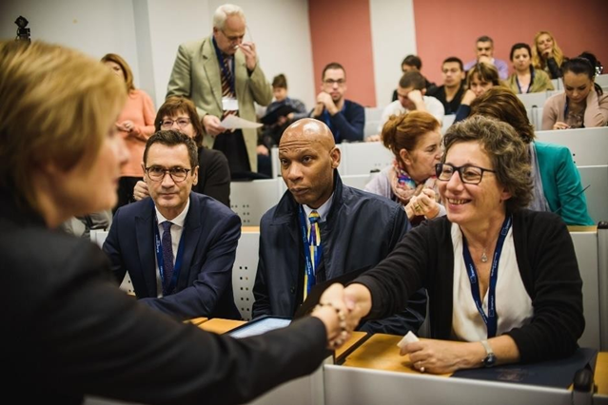

Our international participants representing countries from all over the world

Slide 25
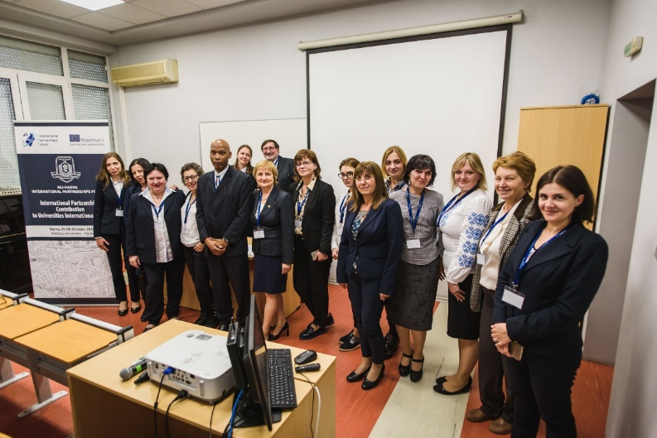
Outcomes – priority activities
International mobility of students, academic and non-academic staff;
Internationalisation at home and digital learning;
International research collaboration/innovation;
Strategic partnerships and capacity building.
Established in 2016, the Research Institute invites international partners in significant scientific projects of MU-Varna.

Slide 26
International Partnerships for Youth - Students’ Life and Erasmus+
Second International Partnerships Forum
16 -17 October 2017

Slide 27
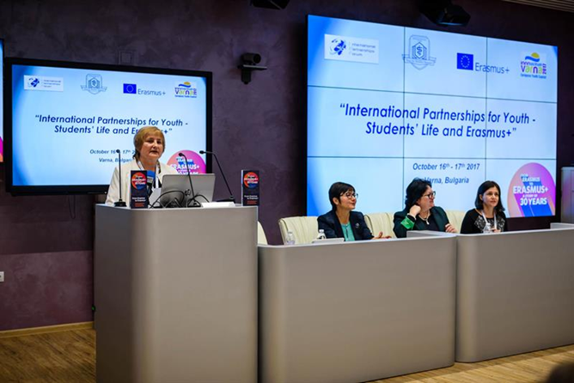
Main accent - the role of partnerships in the development of modern education, scientific and cultural exchange as well as in the process of universities internationalisation and networking.

Slide 28
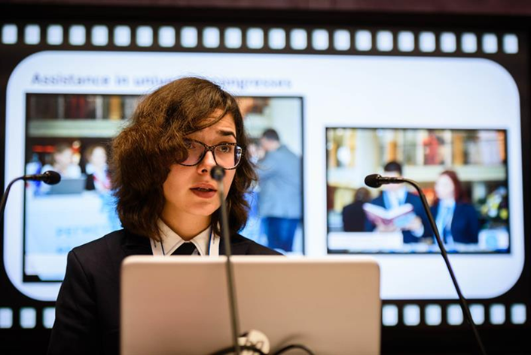
Scope of the meeting - students’ and young researchers’ life and activities during their academic studies, encouragement of the mobility process, enhancement of cooperation, information circulation, sharing ideas and best practices among the participants.

Slide 29
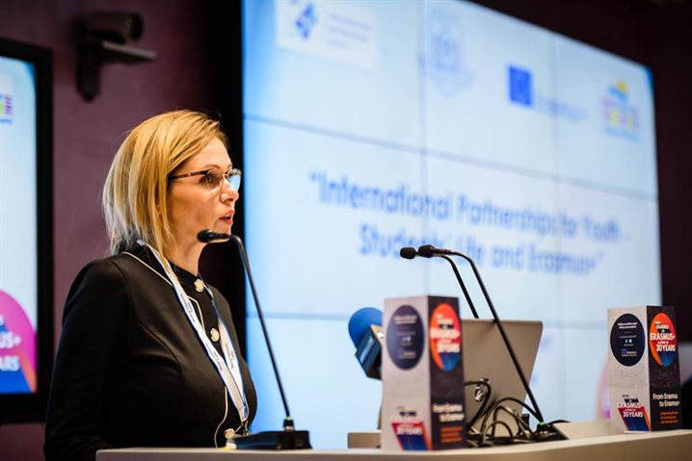
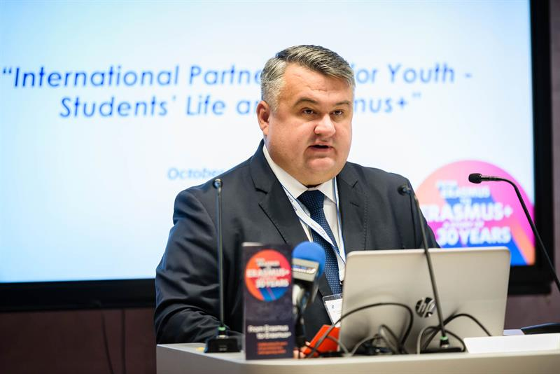
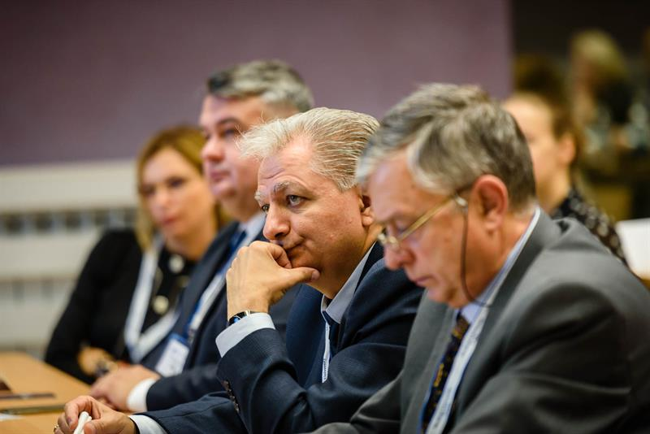
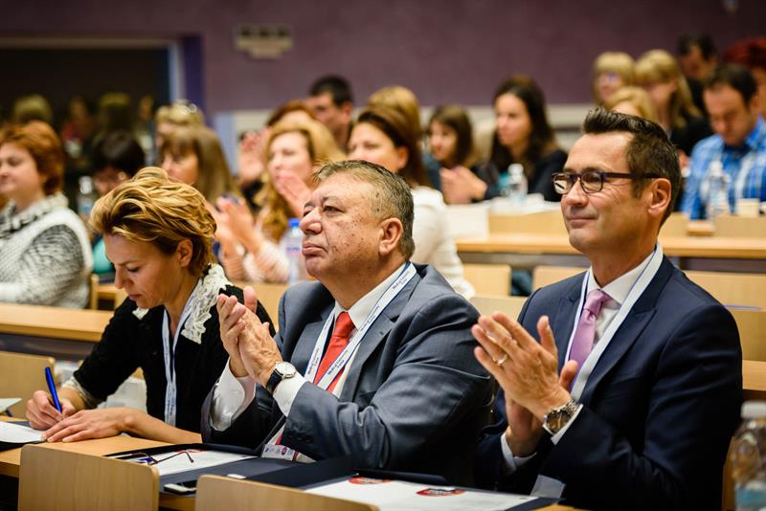
Our international participants representing
countries from all over the world

Slide 30
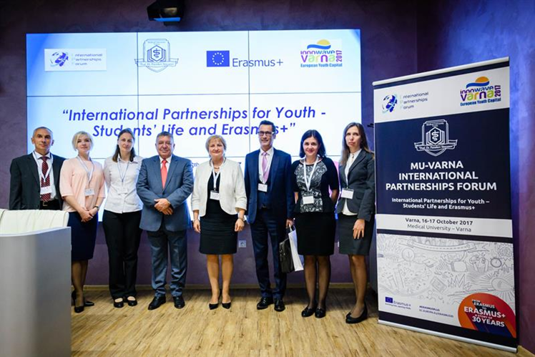
The programme
Presentations of the participants’ institutions
The main role was given to the students: presentations from Students’ Council, Associations of the students of medicine, dental medicine, pharmacy and public health, foreign students (activities, campaigns and other initiatives)
Workshops: “Erasmus+” mobility, “Science and research”, “Culture and cuisine”, “Sports”.

Slide 31
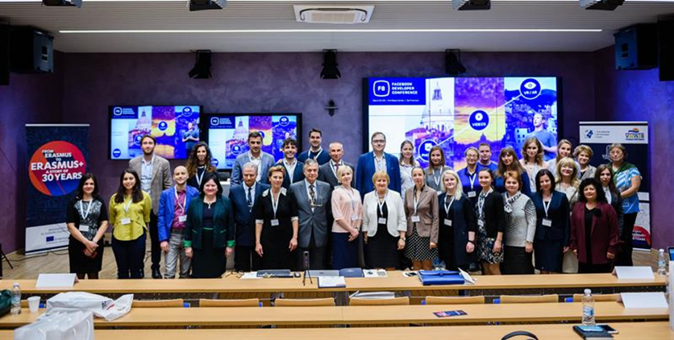
Outcome - consensus for the implementation of specific joint projects.

Slide 32
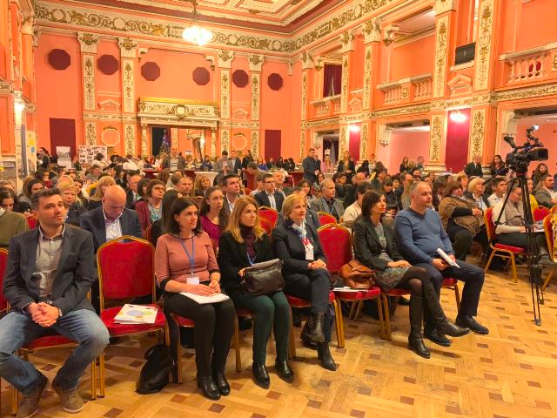
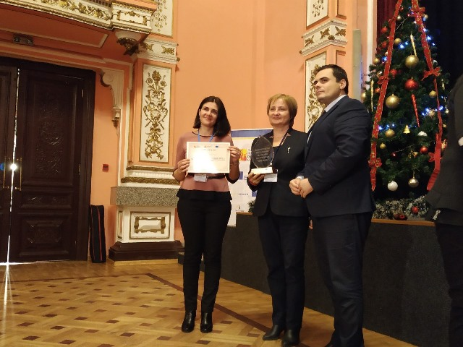
“Erasmus +” Award
For the most active in student and academic staff mobility and best management quality

Slide 33
First International Partnerships Forum
Role of International Partnerships in the Modern Development of Education and Healthcare
8th October 2016

Slide 34
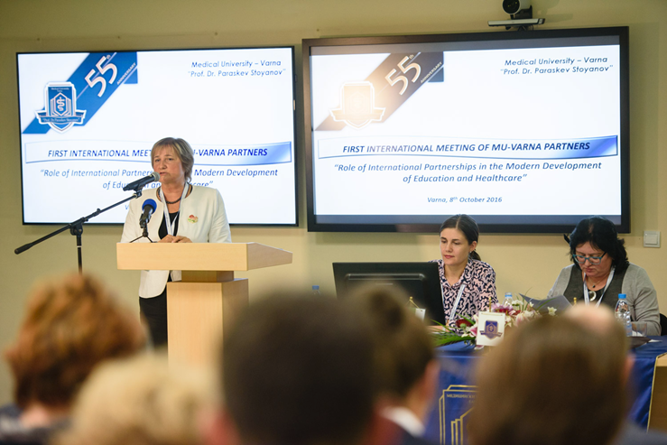

Inspired and organized in the framework of the 55th Anniversary from the establishment of the Medical University - Varna

Slide 35
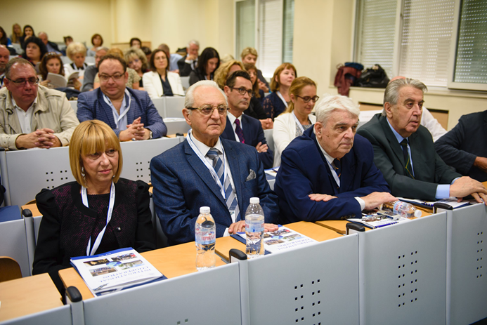
Main accent - the role of international partnerships in the development of Medical University - Varna as a modern educational institution.

Slide 36
Main purpose
Development of larger scale collaborations and shifting from bilateral to multilateral partnerships;
Formation of teams for the preparation and implementation of long-term research projects in accordance with the scientific priorities of the University;
Organization of cultural and sports initiatives in a multi-cultural environment including for humanitarian causes.

Slide 37
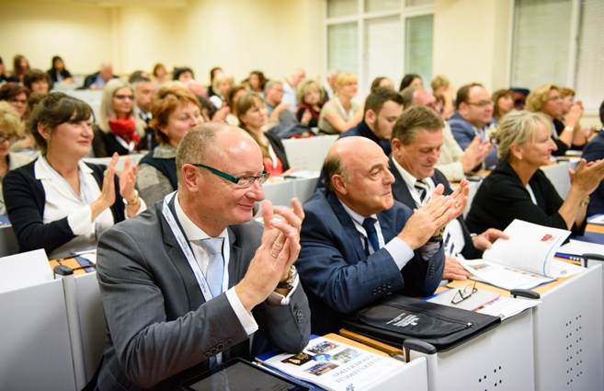
Sharing activities and ideas with more than 25 of international partners of our university in live discussions and presentations.
It launched an innovative platform for the multiplication, clarification, development, risks mitigation and broadening the chances for further successful implementation.
Initiation of a new type of cooperation among our partners with the purpose of turning this meeting into a tradition.

Slide 38
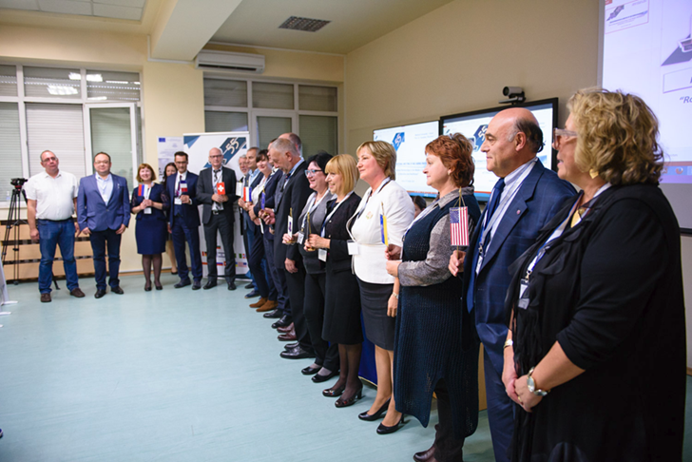
Creation of an academic platform where our partners can share ideas thus generating fruitful educational and scientific projects and achievements.
Establishment and development of a sustainable network of international partners.
The flag parade during the meeting was a new instrument taken from the good practices of our international partners.

Slide 39

From bilateral to multilateral and multisectoral partnerships

